Slide 1
Variables!
Micro:Bit Lesson 1

Slide 2
What are variables?
In software programming, variables are names used to hold one or more values.
Used to store information that can be called upon for later use.

Slide 3
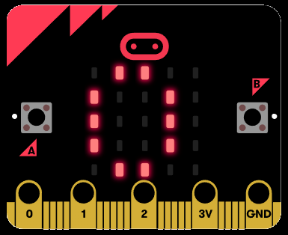
Variables in Micro:Bit
Use let to create variable foo then assign the value 5
Ex:
let foo = 5
basic.showNumber(foo)

Slide 4
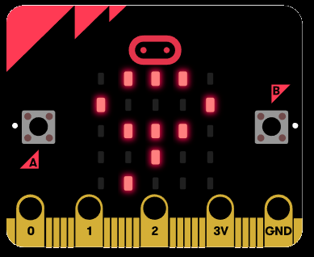
You can change your Variables!
To change a variable, simply reassign another number.
Assign the value 9 to foo
Ex:
let foo = 5
foo = 9
basic.showNumber(foo)

Slide 5
Conditionals!
Micro:Bit Lesson 2

Slide 6
What are conditionals?
A conditional is something that looks for either true or false to determine what the program should do.

Slide 7
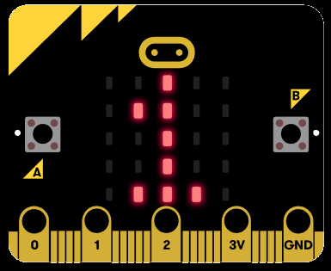
Conditionals in Micro:Bit
We have a variable named foo. We will use an if statement to check if the value is equal to 5 or not. Since the condition is TRUE, foo will assigned foo the value 1.
Ex:
let foo = 5;
if (foo == 5){
foo = 1;
} else {
foo = 9;
}
basic.showNumber(foo)

Slide 8
Loops!
Micro:Bit Lesson 3

Slide 9
What are loops?
In computer science, a loop is a programming structure that repeats a sequence of instructions until a specific condition is met.
Programmers use loops to cycle through values, add sums of numbers, repeat functions, and many other things.

Slide 10
There are two types of loops

Slide 11
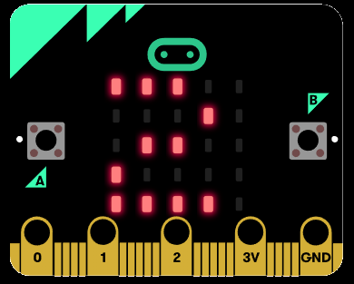
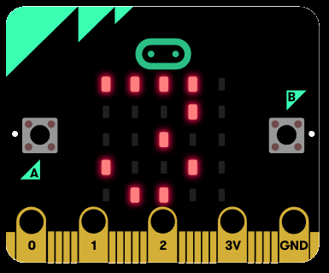
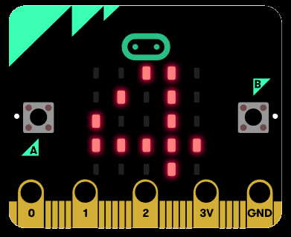
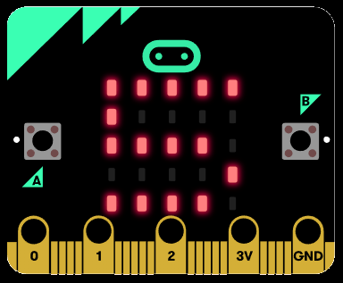
For Loops in Micro:Bit
A for loop will run until the condition in the middle is met (Note: will re-write this later)
Ex:
let i = 0
for (i = 0; i < 5; i++) {
basic.showNumber(i)
}

Slide 12
While Loops in Micro:Bit
A while loop will run until the condition is not true (Note: will re-write this later)
Ex:
let foo = 0
while (foo < 5) {
foo = foo + 1
basic.showNumber(foo)
}

Slide 13
I/O!
Micro:Bit Lesson 4

Slide 14
I/O in Micro:Bit
I/O stands for input and output. This is how you will interface with your Micro:Bit. One way you can input information to the Micro:Bit is through Pins.

Slide 15
What are pins?
You can think of a pin like a light switch. It can be either ON or OFF.
ON = 1
OFF = 0

Slide 16
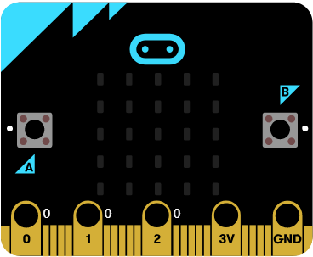
Where are the pins?
There are 4 main pins on your Micro:Bit. They are located at the bottom of the machine.
Pin 1
Pin 2
Pin 3
Ground Pin

Slide 17
How to use a pin
You can turn a pin ON by holding the GND pin and touching either of the three pins.

Slide 18
Change pin 1 to ON
You can turn pin 1 ON by holding the GND pin and touching pin number 1.

Slide 19
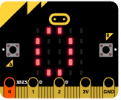
Pin 0 code
Ex:
Let foo0 = 0
input.onPinPressed(TouchPin.P0, function () {
basic.showNumber(foo0)
})

Slide 20
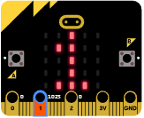
Pin 1 code
Ex:
Let foo1 = 1
input.onPinPressed(TouchPin.P1, function () {
basic.showNumber(foo1)
})

Slide 21
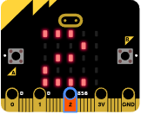
Pin 2 code
Ex:
Let foo2 = 2
input.onPinPressed(TouchPin.P2, function () {
basic.showNumber(foo2)
})

Slide 22
Buttons!
Micro:Bit Lesson 4

Slide 23
What are Buttons?
Buttons are used to sent information to the Mirco:Bit from the user.

Slide 24
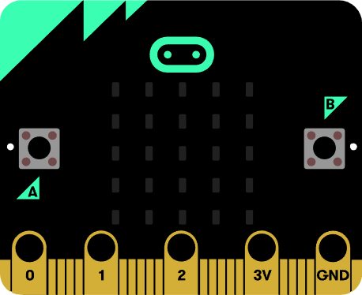
Button.A
Button.B

Slide 25
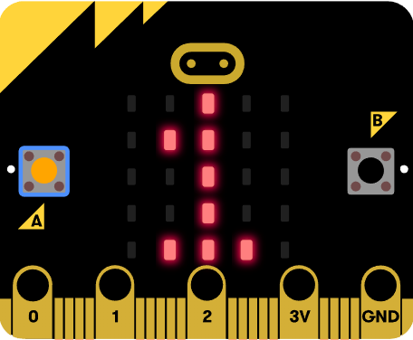
Show number 1 when A is pressed
Ex:
input.onButtonPressed(Button.A, function () {
basic.showNumber(1)
})

Slide 26
Radio!
Micro:Bit Lesson 5

Slide 27
What is radio?
Radio is the technology of signaling or communicating using radio waves.
Micro: Bit can use this technology to send information to other Micro:Bits.

Slide 28
Send signal
Using channel: 25
Sending Number: 1
Ex:
radio.setGroup(25)
radio.sendNumber(1)
radio.onReceivedNumber(function (receivedNumber) { basic.showNumber(receivedNumber)
})
Micro:Bit 1
Micro:Bit 2

